Slide 1

Software Testing JUnit
Kamal Beydoun
Software Engineering
Lebanese University
Faculty of Sciences I

Slide 2
Testing
Testing is the activity of finding out whether a piece of code (a method, a class, or program) produces the intended behavior.

Slide 3
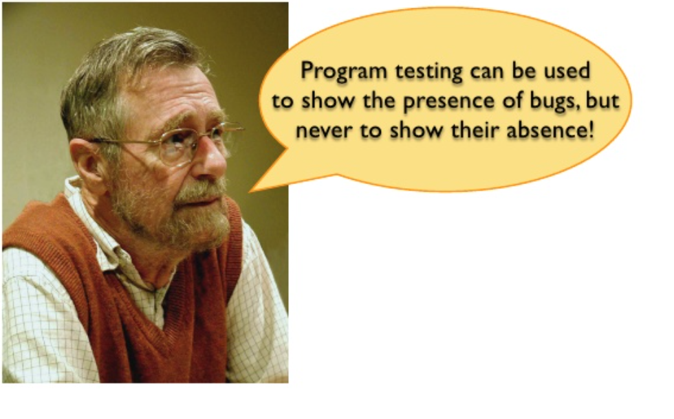
Edsger Dijkstra

Slide 4
Economics
The earlier a defect (bug) is found, the cheaper it is to fix it!
Cost to fix a defect |  | Time introduced
 |  | Requirements | Architecture | Construction
 | Requirements | 1x | - | -
 | Architecture | 3x | 1x | -
Time detected | Construction | 5-10x | 10x | 1x
 | System test | 10x | 15x | 10x
 | Post-release | 10-100x | 25-100x | 10-25x
A study conducted by NIST in 2002 reports that software bugs cost the U.S. economy $59.5 billion annually.
Source: McConnell, Steve (2004). Code Complete (2nd ed.). Microsoft Press.
Notes:
It is commonly believed that the earlier a defect is found, the cheaper it is to fix it. The following table shows the cost of fixing the defect depending on the stage it was found. For example, if a problem in the requirements is found only post-release, then it would cost 10–100 times more to fix than if it had already been found by the requirements review.
In general, the principle is to find an error as close as possible to the time at which it was introduced. The longer the defect stays in the software food chain, the more damage it causes further down the chain. Since requirements are done first, requirements defects have the potential to be in the system longer and to be more expensive. Defects inserted into the software upstream also tend to have broader effects than those inserted further downstream. That also makes early defects more expensive.

Slide 5
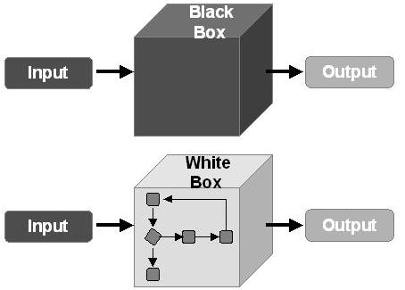
Test Methods - The box approach
Notes:
Software testing methods are traditionally divided into white- and black-box testing. These two approaches are used to describe the point of view that a test engineer takes when designing test cases.

Slide 6
Black-box testing
Treats software under test as a black-box without knowing its internals.
Tests are using software interfaces and trying to ensure that they work as expected. As long as functionality of interfaces remains unchanged, tests should pass even if internals are changed.
Tester is aware of what the program should do but does not have the knowledge of how it does it.
It provides external perspective of the software under test.
Notes:
also known as functional testing)
Black-box testing is most commonly used type of testing in traditional organizations that have testers as a separate department, especially when they are not proficient in coding and have difficulties to understand the code.

Slide 7
Black-box testing
Some of the advantages of black-box testing are:
Efficient for large segments of code
Code access is not required
Separation between user’s and developer’s perspectives
Some of the disadvantages of black-box testing are:
Limited coverage since only a fraction of test scenarios is performed
Inefficient testing due to tester’s lack of knowledge about software internals
Blind coverage since tester has limited knowledge about the application

Slide 8
White-box testing
It looks inside the software and uses that knowledge as part of the testing process. If, for example, exception is thrown under certain conditions, the test might want to reproduce those conditions.
Requires internal knowledge of the system and programming skills.
It provides internal perspective of the software under test.
Notes:
also known as clear box testing, glass box testing, transparent box testing, and structural testing

Slide 9
White-box testing
Some of the advantages of white-box testing are:
Efficient in finding errors and problems
Required knowledge of internals of the software under test is beneficial for thorough testing
Allows finding hidden errors
Programmers introspection
Helps optimizing the code
Due to required internal knowledge of the software, maximum coverage is obtained
Some of the disadvantages of white-box testing are:
Might not find unimplemented or missing features
Requires high level knowledge of internals of the software under test
Requires code access

Slide 10
Test Levels
Unit testing on individual units of source code (=smallest testable part)
Integration testing on groups of individual software modules
System testing on a complete, integrated system (evaluate compliance with requirements)

Slide 11
Unit Testing
Tests the smallest individually executable code units. Usually done by programmers. Test cases might be selected based on code, specification, intuition, etc.
Tools:
Test driver/harness
Code coverage analyzer
Automatic test case generator

Slide 12
Integration Testing
Tests interactions between two or more units or components. Usually done by programmers. Emphasizes interfaces.
Issues:
In what order are units combined?
How do you assure the compatibility and correctness of externally-supplied components?

Slide 13
Integration Testing
How are the units integrated? What are the implications of this order?
Top-down need stubs; top-level tested repeatedly
Bottom-up need drivers; bottom-levels tested repeatedly
Critical units first stubs and drivers needed; critical units tested repeatedly
Notes:
stubs (methods with empty bodies)

Slide 14
Integration Testing
Potential problems:
Inadequate unit testing
Inadequate planning & organization for integration testing
Inadequate documentation & testing of externally-supplied components

Slide 15
System Testing
Test the functionality of the entire system. Usually done by professional testers.
Realities:
Not all problems will be found no matter how full or systematic the testing.
Testing resources (staff, time, tools, labs) are limited.
Specifications are frequently unclear/ambiguous and changing (and not necessarily complete and up-to-date).
Systems are almost always too large to permit test cases to be selected based on code characteristics.
Exhaustive testing is not possible.
Testing is creative and difficult.
Testing must be planned.

Slide 16
System Testing
Types:
Alpha Testing
It is carried out by the test team within the developing organization.
Beta Testing
It is performed by a selected group of friendly customers.
Acceptance Testing
It is performed by the customer to determine whether to accept or reject the delivery of the system.
Performance Testing
It is carried out to check whether the system meets the nonfunctional requirements identified in the SRS document

Slide 17
Different Types of Testing
Installation Testing
Smoke and Sanity Testing
Functional & Non-Functional Testing
Continuous Testing
Destructive Testing
Usability Testing
Development Testing
A/B Testing
Concurrent Testing
Regression Testing

Slide 18
Installation, Smoke & Sanity Testing
Installation Testing
An installation test assures that the system is installed correctly and working at actual customer's hardware.
Smoke Testing
Smoke testing consists of minimal attempts to operate the software, designed to determine whether there are any basic problems that will prevent it from working at all. Such tests can be used as build verification test.
Sanity Testing
Sanity testing determines whether it is reasonable to proceed with further testing.

Slide 19
Functional & Non-Functional Testing
Functional testing
It refers to activities that verify a specific action or function of the code. These are usually found in the code requirements documentation, although some development methodologies work from use cases or user stories. Functional tests tend to answer the question of "can the user do this" or "does this particular feature work.”
Non-functional testing
It refers to aspects of the software that may not be related to a specific function or user action, such as scalability or other performance, behavior under certain constraints, or security. Testing will determine the breaking point, the point at which extremes of scalability or performance leads to unstable execution. Non-functional requirements tend to be those that reflect the quality of the product, particularly in the context of the suitability perspective of its users.

Slide 20
Continuous, Destructive & Usability Testing
Continuous testing
It is the process of executing automated tests as part of the software delivery pipeline to obtain immediate feedback on the business risks associated with a software release candidate.
Destructive testing
It attempts to cause the software or a sub-system to fail. It verifies that the software functions properly even when it receives invalid or unexpected inputs, thereby establishing the robustness of input validation and error-management routines.
Usability testing
It is to check if the user interface is easy to use and understand. It is concerned mainly with the use of the application.

Slide 21
Development, A/B & Concurrent Testing
Development Testing
It is a software development process that involves synchronized application of a broad spectrum of defect prevention and detection strategies in order to reduce software development risks, time, and costs.
A/B testing
It is basically a comparison of two outputs, generally when only one variable has changed: run a test, change one thing, run the test again, compare the results. This is more useful with more small-scale situations, but very useful in fine-tuning any program.
Concurrent testing
The focus is on the performance while continuously running with normal input and under normal operational conditions, as opposed to stress testing, or fuzz testing. Memory leak, as well as basic faults are easier to find with this method.

Slide 22
Regression Testing
Test modified versions of a previously validated system.
Usually done by testers.
The goal is to assure that changes to the system have not introduced errors (caused the system to regress).
The primary issue is how to choose an effective regression test suite from existing, previously-run test cases.
Notes:
Regression testing focuses on finding defects after a major code change has occurred. Specifically, it seeks to uncover software regressions, as degraded or lost features, including old bugs that have come back. Such regressions occur whenever software functionality that was previously working correctly, stops working as intended.

Slide 23
Test Automation
Test execution: Run large numbers of test cases/suites without human intervention.
Test generation: Produce test cases by processing the specification, code, or model.
Test management: Log test cases & results; map tests to requirements & functionality; track test progress & completeness
Notes:
Many programming groups are relying more and more on automated testing, especially groups that use test-driven development. There are many frameworks to write tests in, and continuous integration software will run tests automatically every time code is checked into a version control system.
While automation cannot reproduce everything that a human can do (and all the ways they think of doing it), it can be very useful for regression testing. However, it does require a well-developed test suite of testing scripts in order to be truly useful.

Slide 24
Why should tests be automated?
More testing can be accomplished in less time.
Testing is repetitive, tedious, and error-prone.
Test cases are valuable – once they are created, they can and should be used again, particularly during regression testing.

Slide 25
Test Automation Issues
Does the payoff from test automation justify the expense and effort of automation?
Learning to use an automation tool can be difficult.
Tests, have a finite lifetime.
Completely automated execution implies putting the system into the proper state, supplying the inputs, running the test case, collecting the results, and verifying the results.

Slide 26


Slide 27


What is JUnit?
JUnit is an open source framework that has been designed for the purpose of writing and running tests in the Java programming language.
Originally written by Erich Gamma and Kent Beck University of Calgary.

Slide 28
Regression-Testing Framework
JUnit is a regression-testing framework that developers can use to write unit tests as they develop systems.
This framework creates a relationship between development and testing. You start coding according to the specification and need. After that you use the JUnit test runners to verify how much it deviates from the intended goal.
This really helps to develop test suites that can be run any time when you make any changes in your code.
This all process will make you sure that the modifications in the code will not break your system without your knowledge.

Slide 29

Why Use JUnit?
Graphical user interface (GUI) which makes it possible to write and test source code quickly and easily.
Write and run repeatable tests.
Programmers normally write their code, then write tests for it.
Better to write tests while writing code!
JUnit provides a framework to keep tests small and simple to test specific areas of code.
JUnit shows test progress in a bar that is green if testing is going fine and it turns red when a test fails.
Multiple tests can run concurrently. The simplicity of JUnit makes it possible for the software developer to easily correct bugs as they are found.

Slide 30
JUnit helps the programmer
Define and execute tests and test suites
Formalize requirements and clarify architecture
Write and debug code
Integrate code and always be ready to release a working version
Typically, in a unit testing, we start testing after completing a module but JUnit helps us to code and test both during the development. So it sets more focus on testing the fundamental building blocks of a system i.e. one block at a time rather than module level functional testing.

Slide 31
Download & Installation of JUnit
Eclipse has JUnit already included, therefore if you intend to use JUnit within Eclipse you don't have to download anything.
https://junit.org/junit5/

Slide 32
Guidelines for using JUnit
Make sure to test before and after integration with other modules.
Assume a feature DOESN’T work until you have proven that it does by testing everything that could possibly break.
Use informative test names.
Try to test only one thing per method to make it easier to find where error occurred.
Write tests immediately after you write the function, when it’s fresh in your mind.

Slide 33
What JUnit does
JUnit runs a suite of tests and reports results.
For each test in the test suite:
JUnit calls setUp()
This method should create any objects you may need for testing
JUnit calls tearDown()
This method should remove any objects you created
JUnit calls once the test method
The test method may comprise multiple test cases; that is, it may make multiple calls to the method you are testing
In fact, since it’s your code, the test method can do anything you want
The setUp() method ensures you entered the test method with a virgin set of objects; what you do with them is up to you

Slide 34
JUnit framework

Slide 35


Slide 36
Coding Convention for JUnit Class
Name of the test class must end with "Test".
Name of the method must begin with "test".
Return type of a test method must be void.
Test method must not throw any exception.
Test method must not have any parameter.
Test methods must be annotated by the @Test annotation.

Slide 37
Standards for unit tests
You should write a test case for the method which is less dependent on sub method.
If you write a test case for dependent methods, your test may fail because the sub method can return wrong value. So, it may take longer to find out the source of the problem.
Each test case has to be in the same package as the code to be tested.
Although, it is nice to cover most of the code in the test cases, it is not advisable to use 100% of the code. If the method is too simple then there is no point of writing unit test for it.

Slide 38
Creating a test class in JUnit
Override the setUp() method to initialize object(s) under test.
Override the tearDown() method to release object(s) under test.
Define one or more public testX() methods that exercise the object(s) under test and assert expected results.
Define a static suite() factory method that creates a TestSuite containing all the testX() methods.
Optionally define a main() method that runs the test in batch mode.

Slide 39
Fixtures
A fixture is just the code you want to run before every test.
It’s all the things that must be in place in order to run a test and expect a particular outcome. In JUnit a test fixture is a Java object.
You get a fixture by overriding the method
protected void setUp() { …}
The general rule for running a test is:
protected void runTest() {
setUp();
<run the test>
tearDown();
}
so we can override setUp and/or tearDown, and that code will be run prior to or after every test case.
Notes:
Tests need to run against the background of a known set of objects. This set of objects is called a test fixture. When you are writing tests you will often find that you spend more time writing the code to set up the fixture than you do in actually testing values.

Slide 40

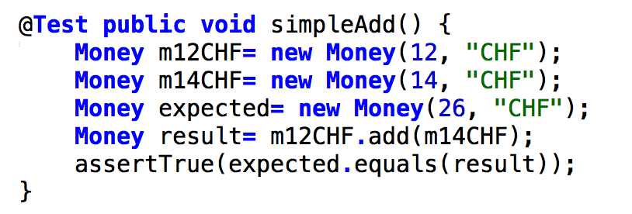
Example: Currency
Test that the sum of two Moneys with the same currency contains a value which is the sum of the values of the two Moneys.
But what if you have two or more tests that operate on the same or similar sets of objects?!

Slide 41
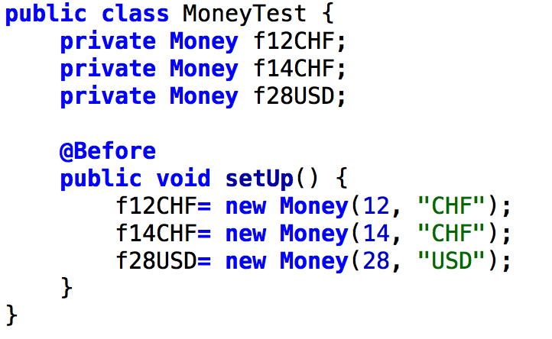
Example: Currencies
You want to write several test cases that want to work with different combinations of 12 Swiss Francs, 14 Swiss Francs, and 28 US Dollars.
First you create a fixture:
Once you have the Fixture in place, you can write as many Test Cases as you'd like. Add as many test methods (annotated with @Test) as you'd like.

Slide 42
Example: Calculator
package org.example.antbook.junit;
import org.junit.*;
public class TestCalculator {
public TestCalculator(String name) {
super(name);
}
Calculator calculator;
@Override
protected void setUp() throws Exception {
calculator = new Calculator();
}
public void testAdd() {
// int sum = calculator.add(8, 7);
// assertEquals(sum, 15);
assertEquals(15, calculator.add(8, 7));
}
@Override
protected void tearDown() throws Exception {
// Clean up, like
calculator = null;
}
}
Override setUp() method to perform initialization
Define one or more testX() methods that can perform the tests and assert expected results
Override tearDown() method to clean up

Slide 43
Implementing setUp() & tearDown() method
Override setUp() to initialize the variables, and objects
Since setUp() is your code, you can modify it any way you like (such as creating new objects in it)
Reduces the duplication of code
In most cases, the tearDown() method doesn’t need to do anything.
The next time you run setUp(), your objects will be replaced, and the old objects will be available for garbage collection.
Like the finally clause in a try-catch-finally statement, tearDown() is where you would release system resources (such as streams)

Slide 44
@Before/After - Junit 5⁺
import org.junit.*;
import static org.junit.Assert.*;
class <name> {
...
@BeforeAll
void <name>() {
....
}
@AfterAll
void <name>() {
....
}
}
methods to be run before or after all/each test case(s)
Because a new instance is created for each test, there is no obvious instance on which to call the @BeforeAll/@AfterAll methods, so they have to be static.
@BeforeAll Executed once; runs before the tests and methods marked with @BeforeEach.
@BeforeEach Executed before each test.
@AfterEach Executed after each test.
@AfterAll Executed once; runs after all tests and methods marked with @AfterEach.
@BeforeEach
void <name>() {
....
}
@AfterEach
void <name>() {
....
}
Notes:
Static import is a feature introduced in the Java programming language that allows members (fields and methods) defined in a class as public static to be used in Javacode without specifying the class in which the field is defined. This feature was introduced into the language in version 5.0.
@BeforeAll Executed once; runs before the tests and methods marked with @BeforeEach.
@BeforeEach Executed before each test.
@AfterEach Executed after each test.
@AfterAll Executed once; runs after all tests and methods marked with @AfterEach.
Because a new instance is created for each test, there is no obvious instance on which to call the @BeforeAll/@AfterAll methods, so they have to be static.

Slide 45
@Test- Junit 5⁺
class <name> {
...
@Test
void succeedingTest() {
.... // executed
}
@Test
@Disabled("for demo purposes")
void <name> () {
.... // not executed
}
}
Neither test classes nor test methods need to be public!
@Test
marks methods that are to be run as tests.
We can also disable a whole test class
& we can use:
@DisabledOnOs(WINDOWS)
@EnabledOnOs({ LINUX, MAC })
@EnabledOnJre(JAVA_8)

Slide 46
The structure of a test method
A test method doesn’t return a result.
If the tests run correctly, a test method does nothing.
If a test fails, it throws an AssertionFailedError
The JUnit framework catches the error and deals with it, so you don’t have to do anything

Slide 47
JUnit 5⁺ assertions
assert can be explained as must be.
public void assertTrue(boolean condition)
public void assertTrue(boolean condition, String message)
public void assertTrue(boolean condition, Supplier<String> messageSupplier)
public void assertTrue(BooleanSupplier conditionSupplier)
public void assertTrue(BooleanSupplier conditionSupplier, String message)
public void assertTrue(BooleanSupplier conditionSupplier, Supplier<String> messageSupplier)
Notes:
assert can be explained as must be.

Slide 48
//assertTrue(boolean condition)
@Test
public void primeNumberTestwithCondition(){
Assertions.assertTrue(att.isPrime(5));
}
// assertTrue(boolean condition, String message)
@Test
public void primeNumberTestwithConditionAndMessage( ) {
Assertions.assertTrue(att.isPrime(91),"Number is not prime");
}
// assertTrue(BooleanSupplier booleanSupplier)
@Test
public void primeNumberTestWithBooleanSupplier(){
Assertions.assertTrue(() -> att.isPrime(7));
}
// assertTrue(boolean condition, Supplier<String> messageSupplier)
@Test
public void primeNumberTestWithConditionAndSupplier(){
Assertions.assertTrue(att.isPrime(13),() -> "Number is not prime");
}
// assertTrue(BooleanSupplier booleanSupplier, String message)
@Test
public void primeNumberTestWithBooleanSupplierAndMessage(){
Assertions.assertTrue(() -> att.isPrime(17),"Number is not prime");
}
// assertTrue(BooleanSupplier booleanSupplier, Supplier<String> messageSupplier)
@Test
public void primeNumberTestWithBooleanSupplierAndSupplier(){
Assertions.assertTrue(() -> att.isPrime(89),() -> "Number is not prime");
}
}

Slide 49
Sample Assertions
static void assertEquals (boolean expected, boolean actual)
Asserts that two booleans are equal
static void assertEquals (byte expected, byte actual)
Asserts that two bytes are equal
static void assertEquals (char expected, char actual)
Asserts that two chars are equal
static void assertEquals (double expected, double actual, double delta)
Asserts that two doubles are equal concerning a delta
static void assertEquals (float expected, float actual, float delta)
Asserts that two floats are equal concerning a delta
static void assertEquals (int expected, int actual)
Asserts that two ints are equal

Slide 50
JUnit 5⁺ assertions
@Test
void standardAssertions() {
assertEquals(2, 2);
assertEquals(4, 4, "The optional assertion message is now the last parameter.");
assertTrue('a' < 'b', () -> "Assertion messages can be lazily evaluated – “+ "to avoid constructing complex messages unnecessarily.");
}

Slide 51
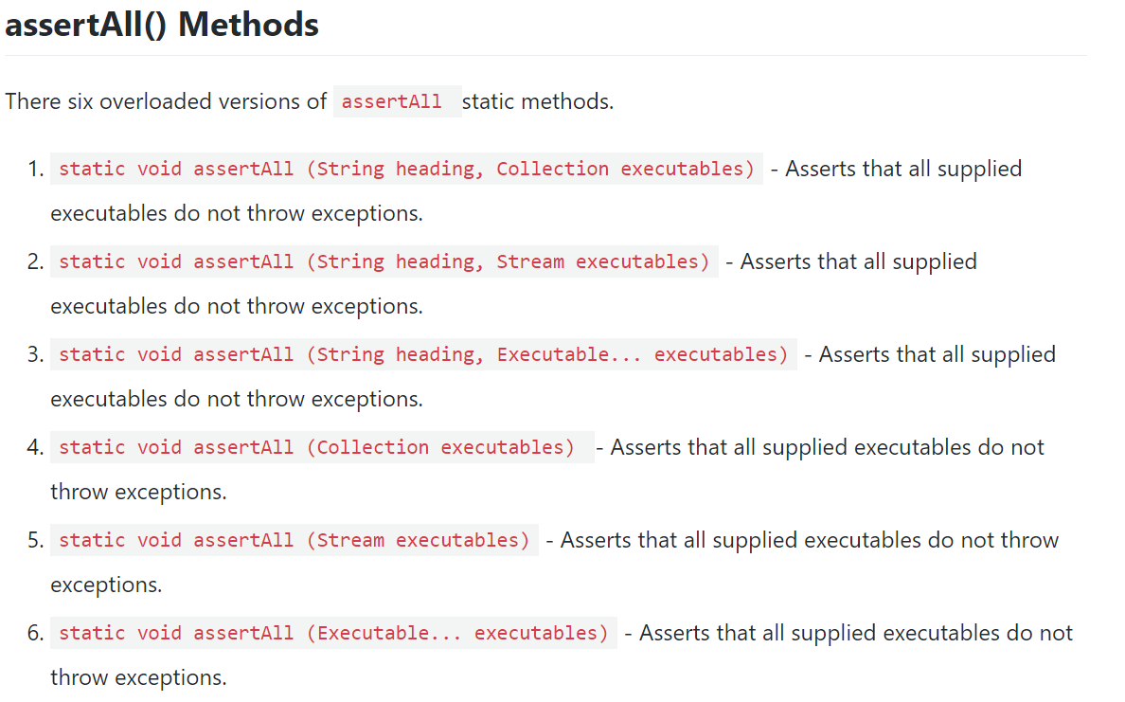
AssertALL

Slide 52
Assertions - Junit 5⁺
@Test
void dependentAssertions() {
// Within a code block, if an assertion fails the
// subsequent code in the same block will be skipped.
assertAll("properties",
() -> {
String firstName = person.getFirstName();
assertNotNull(firstName);
// Executed only if the previous assertion is valid.
assertAll("first name",
() -> assertTrue(firstName.startsWith("J")),
() -> assertTrue(firstName.endsWith("n"))
);
},
() -> {
// Grouped assertion, so processed independently
// of results of first name assertions.
String lastName = person.getLastName();
assertNotNull(lastName);
// Executed only if the previous assertion is valid.
assertAll("last name",
() -> assertTrue(lastName.startsWith("D")),
() -> assertTrue(lastName.endsWith("e"))
);
}
);
}
Grouped Assertions
=> Hierarchy of Dependent tests

Slide 53
Performance Test - JUnit 5⁺
assertTimeout(ofSeconds(5),
() -> {
// ... Code that may take so long
} , () -> "The above code took more than 5secs");
assertTimeoutPreemptively(ofSeconds(5),
() -> {
// ... Code that may take so long
} , () -> "The above code took more than 5secs & was aborted");
The above method will be considered a failure if it doesn't finish running within 5s
Requires Java 8⁺

Slide 54
Repeat Test
1 2 3 4 | @RepeatedTest(100) void repeatedTest() { // ... }

Slide 55
Testing for exceptions - JUnit 5⁺
public class <name> {
...
@Test
public void <name>() {
assertThrows(AbcXyzException.class,
()-> {
callMethodCausingAnExceptionWith(exceptionalVal);
});
}
}

Slide 56
Testing for exceptions - JUnit 5⁺
assertThrows(Class<T> expectedType, Executable executable, String message)
public class UserTest {
@Test
public void testUsernameIsNull() {
assertThrows(IllegalArgumentException.class, new Executable() {
@Override
public void execute() throws Throwable {
User user = new User();
user.setName(null);
}
});
Executable is a functional interface defined by JUnit.
Notes:
You put the code that can throw exception in the execute() method of an Executable type - Executable is a functional interface defined by JUnit. The message is optional, to be included in the error message printed when the test fails.
@Test
public void testUsernameIsNull() {
assertThrows(IllegalArgumentException.class, () -> {
User user = new User();
user.setName(null);
});
}

Slide 57
Test suites
import org.junit.runner.*;
import org.junit.runners.*;
@RunWith(Suite.class)
@Suite.SuiteClasses({
<test class name>.class,
<test class name>.class
})
public class <name> {}
Suites are groups of tests that can be run together

Slide 58
Test Suites
Test
Test
In practice, you want to run a group of related tests (e.g. all the tests for a class).
To do so, group your test methods in a class.
The Suite allows to run collections of tests and/or other suites in a hierarchically or thematically structured way.
Function
Function
Module
Module
Module
SRunner

Slide 59
Writing Tests for JUnit
Need to use the methods of the assert class
javadoc gives a complete description of its capabilities
Each test method checks a condition (assertion) and reports back to the test runner whether the test failed or succeeded
The test runner uses the result to report to the user (in command line mode) or update the display (in an IDE)
All of the methods return void
A few representative methods of org.junit.assert
assertTrue(boolean)
assertTrue(String, boolean)
assertEquals(Object, Object)
assertNull(Object)
Fail(String)
All the above may take an optional String message as the first argument, for example,
static void assertTrue(String message, boolean test)

Slide 60
Organize The Tests
Create test cases in the same package as the code under test.
For each Java package in your application, define a TestSuite class that contains all the tests for validating the code in the package.
Define similar TestSuite classes that create higher-level and lower-level test suites in the other packages (and sub-packages) of the application.
Make sure your build process includes the compilation of all tests.

Slide 61

xUnit for Other Languages
Ada (AUnit)
C (CUnit)
C# (NUnit)
C++ (CPPUnit, CxxTest)
Erlang (EUnit)
Fortran (fUnit, pFUnit)
Delphi (DUnit)
Free Pascal (FPCUnit)
Haskell (HUnit)
JavaScript (JSUnit)
Microsoft .NET (NUnit)
Objective-C (OCUnit)
OCaml (OUnit)
Perl (Test::Class and Test::Unit)
PHP (PHPUnit)
Python (PyUnit)
R (RUnit)
Ruby (Test::Unit)

Slide 62
Some Important Tips
You should use object oriented best practice for your test code. You should bring all of the common functionalities in the base class. That way you can eliminate duplicate code, long methods etc.
You should use proper method name. it is going to be easier for the team to maintain the code in future.
The JUnit framework automatically handles the exception. It is good idea not to throw an exception in a test that shouldn't throw an exception. Otherwise, it can hide bugs which may be discovered much later stage.
JUnit doesn't provide all of the functionalities to test your code. So, you need an additional test tool. Some of the tools are DBunit, Selenium etc that can be used as an extension of JUnit.
Instead of rely on System.out.println() method to figure out the success of the test, you can rely upon the 'assert' method of JUnit so that you can run the automated test and that way the tester doesn't need to monitor the test in person all the time.

Slide 63
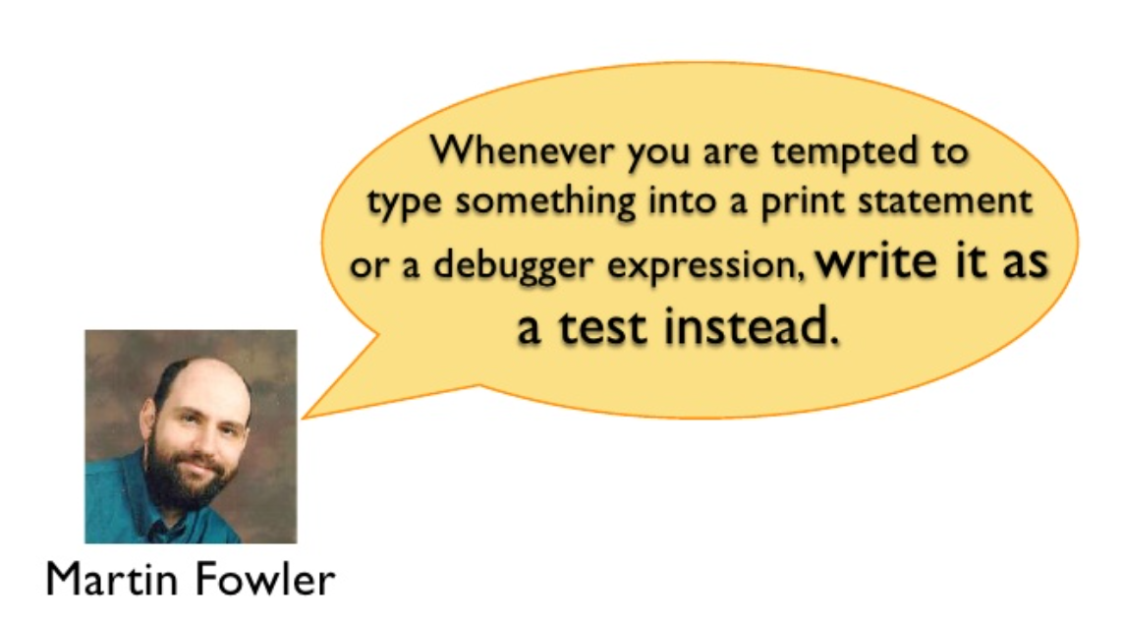
Best Practices

Slide 64
Thanks
JUnit 5 User Guide
https://junit.org/junit5/docs/current/user-guide/

Slide 65

Thank you

